Slide 1
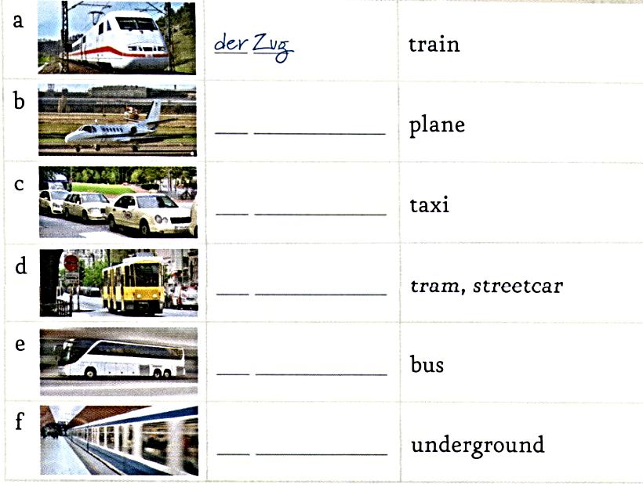

Slide 2
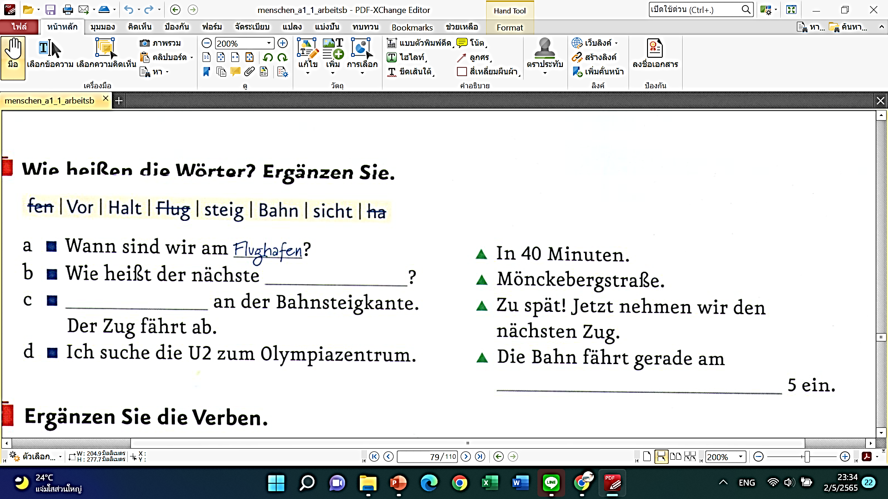

Slide 3
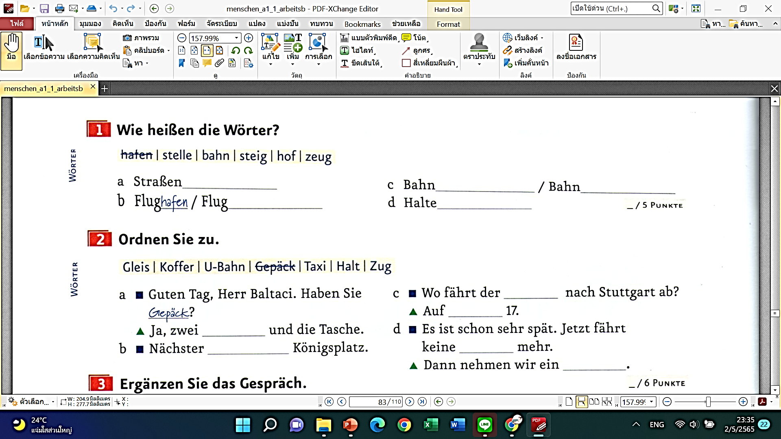

Slide 4
https://create.kahoot.it/details/14eec1f8-3805-4a06-8658-b0f737adef47
kahoot

